Slide 1

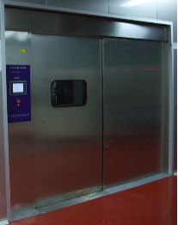
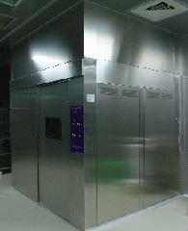

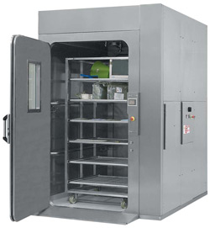
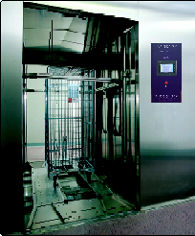
CAGE AND RACK WASHER
LEADER is a professional manufacturer Backed up by 30 years experience in the Asia area of laboratory, pharmaceutical and medical washing / disinfection. So, LEADER has designed ranges of professional washing machines intended to meet all your requirements. 。
Model: Ld-570t
TEL:26587810
FAX:26587801
E-mail:
leador.washer@msa.hinet.net
http//www.leader21tw.net
LEADER ULTRASONIC CO., LTD.
1

Slide 2
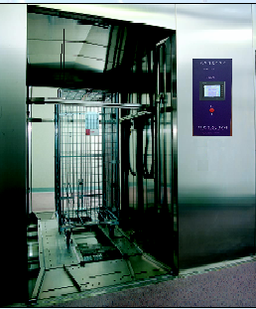
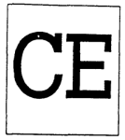

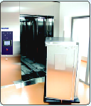
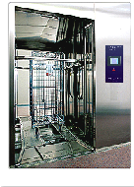
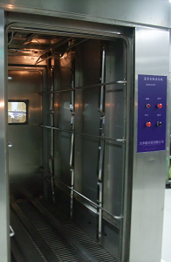
CAGE AND RACK WASHER
Model：LD-570T
Size (W x H x D) ：Overall dimensions:W2500xH3000xL2200mm
Wash chamber：W1100xH2200xL2000mm
APPLICATION：
    The Leader LD-570T Cage and Rack Washer is used for thorough, efficient cleaning of cages, racks, debris pans, bottles and miscellaneous items used in the care of
    laboratory animals.
    DESCRIPTION ：
    The Leader LD-570T Cage and Rack Washer is a heavy-duty, large capacity,
    hydrospray washer, equipped with a
    programmable logic control (PLC)
    system. The washer can be
    programmed to process the following
    phases: pre-wash, alkaline wash, acid
    wash, first rinse, second rinse, final rinse
    and exhaust.
    The washer is available with double
    (pass-through) doors, for either floor- or
    pit-mounting.
NOTE: Washer can be designed in any size to meet new or existing
requirements.
LEADER ULTRASONIC CO., LTD.
2

Slide 3
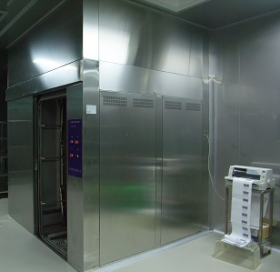
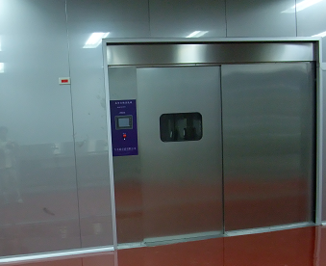
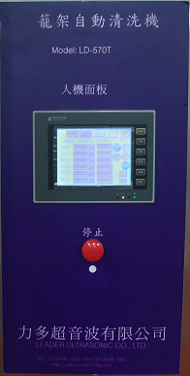
CAGE AND RACK WASHER
Model：LD-570T
Size (W x H x D) ：Overall dimensions:W2500xH3000xL2200mm
Wash chamber：W1100xH2200xL2000mm
STANDARDS:
Each washer meets the applicable requirements of the following standards:
• Underwriters Laboratories EN 60601-1: 2002 CE .
• EN60601-1/1990 EN60601-1-2/2001 EN 60601-1: 2002 Medical electrical equipment part 1 : General requirements for safety of medical electrical systems.
EN 61000-3-2: 2001 Medical electrical equipment part 1 : General requirements for safety,2. collateral standard : Electromagnetic compatibility-Requirements and tests
Standard Features:
- Microprocessor control with HMI touch screen。
-stainless steel pump wash inside and outside with rotary wash arms。
- Automatic exhaust damper。
-All stainless steel construction 。
- process up to 100 cages per load in 50 minutes 。
- rotating spray arms are located on both and up down sides。
- 2 Chemicals Dosing pumps。
- Steam or electrical heating
- Intrinsic door safety。
- 2 Chemicals Dosing pumps
- efficient cleaning of cages,racks,debris pans。。
-Pit mounted or free standing cab
3

Slide 4
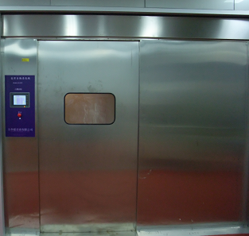
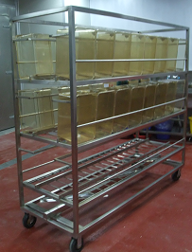
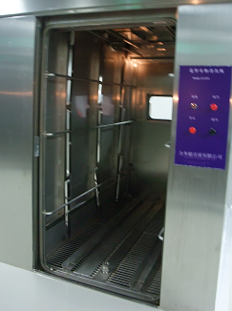
CAGE AND RACK WASHER
Model：LD-570T
Overall ：W2600xH3000xL2200mm
Wash chamber ：W1100xH2200xL2000mm
CONSTRUCTION:
Base, wash chamber, chamber sump and steam coils are
constructed of #304 stainless steel (No. 2B finish). Base
contains integral door gutters and supports to accommodate
floor grating.
Chamber sump includes a mechanical float switch level
control, automatic rinse water fill and stainless-steel steam
heating coil for the recirculated solutions. Sump capacity is 170 L. Steam coil surface area is 20 square feet (1.85 m2), and is easily removable for cleaning or maintenance.
Optional wash solution reservoirs are 100 U.S. gallon (378 L) capacity and are heated by a stainless-steel steam coil. Steam coil surface area is 9.0 square feet (0.84 m2), and is easily removable for cleaning or maintenance.
Chamber floor has heavy-duty stainless-steel grating covering the entire load area. Grating sections are removable for cleaning or maintenance.
Chamber doors are #304 stainless steel, double-wall
construction, insulated with 2.0" (51 mm) thick rigid fiberglass
TEL:26587810
FAX:26587801
E-mail:
leador.washer@msa.hinet.net
http//www.leader21tw.net
LEADER ULTRASONIC CO., LTD.
4

Slide 5

CAGE AND RACK WASHER
model：LD-570T
Overall ：W2600xH3000xL2200mm
Wash chamber ：W1100xH2200xL2000mm
Optional features ：
Wash load documentation。
remote control。
Vent condenser。
Discharge cooling。
Monitoring of pump pressure, temperature, conductivity etc.
Steam heating with High capacity HEPA filtered drying system
Barcode reader for automatic basket identification。
Wide variety of baskets, customer specific manufacture。
SUPPLY CONNECTION：
COLD WATER ：1" NPT, 2-10 bar.
HOT WATER ：1" NPT, 2-10 bar.
RO WATER：1" NPT, 2-6bar.
STEAM:1" NPT, 2-4bar.
COMPRESSED AIR:1/8", 0.5 –4bar
ELECTRICITY： 220V、3pH、50/60Hz 50A
(or 380V、3pH、50/60Hz 30A)
LEADER ULTRASONIC CO., LTD.
5

Slide 6
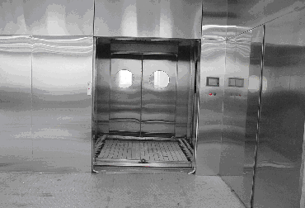
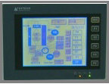
CAGE AND RACK WASHER
model：ld-w200
Overall size：W2850xH2790xL2340mm
Wash chamber ：W1000xH2000xL2080mm
CYCLE DESCRIPTION：
• PRE-WASH (0-99.99 minutes) – water remaining in chamber
sump from final rinse of previous cycle is recirculated
through jet system under pump pressure. On completion,
water is sent to the drain.
• WASH (0-49.99 minutes; ambient –85°C) – hot water
fills the sump and is pumped through the jet system.
Detergent is added from the detergent injection pump. At
the end of the phase the detergent solution is sent to the
drain.
• FIRST RINSE (0-49.99 minutes; ambient –85°C):
hot water fills chamber sump and is recirculated through jet
system under pump pressure. At the end of the phase,
recirculated water is sent to the drain.
• SECOND RINSE (0-49.99 minutes; ambient –85°C)
– hot water fills chamber sump and is recirculated through
jet system under pump pressure. At the end of the phase,
recirculated water is sent to the drain.
• FINAL RINSE (0-49.99 minutes; ambient –85°C) –
same as first rinse, except at the end of the phase, water
may be retained in the chamber sump for use as the
pre-wash water in the next load.
• EXHAUST – washer stands idle until residual vapors are
removed.
LEADER ULTRASONIC CO., LTD.
6

Slide 7
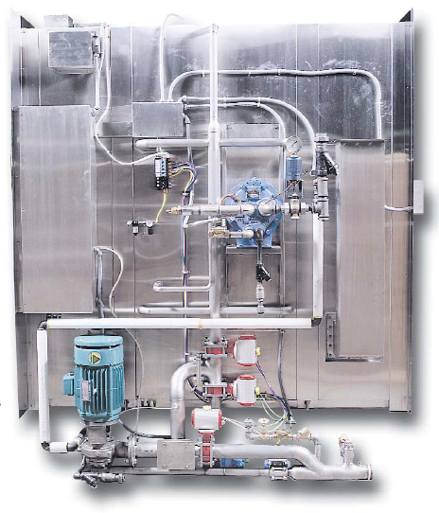
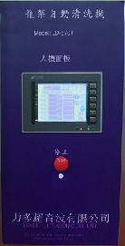
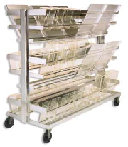
CAGE AND RACK WASHER
SAFETY FEATURES:
Door open safety feature automatically stops washer operation if doors are opened during the cycle. To resume operation, doors must be closed, alarm acknowledged, and START CYCLE button pressed.
Two red safety cables inside the wash chamber (one on each side) immediately stop the washer operation if either one is pulled. To resume operation, alarm must be acknowledged and START CYCLE button pressed.
Doors are equipped with spring-loaded, explosion-relief type safety latches that readily open when pushed from inside the chamber.
Emergency stop button(s). Washer is equipped with an external emergency stop pushbutton at each end that
automatically stops operation of the washer when pressed
Control system
monitors and automatically controls all process operations and functions. Control can retain up to 12 processing cycles in memory, programmed and named according to Customer preferences. Cycle phase times, temperatures, and other key process parameters are
programmable. Once a cycle is started, the programmed cycle values are locked in and cannot be changed until cycle is complete.
The control system consists of an Mithumishi CompactLogix™1 Programmable Logic Controller (PLC) with PanelView Plus HMI touch screen operator interface(s). The system can be connected to an integral optional printer to record process parameters, or to an external printer. An Ethernet port is available for remote monitoring and troubleshooting.
Service mode is accessible through the main control panel for service and maintenance purposes.
Security access code requires entry of a four digit access code to change cycle values.
LEADER ULTRASONIC CO., LTD.
7

